Slide 1
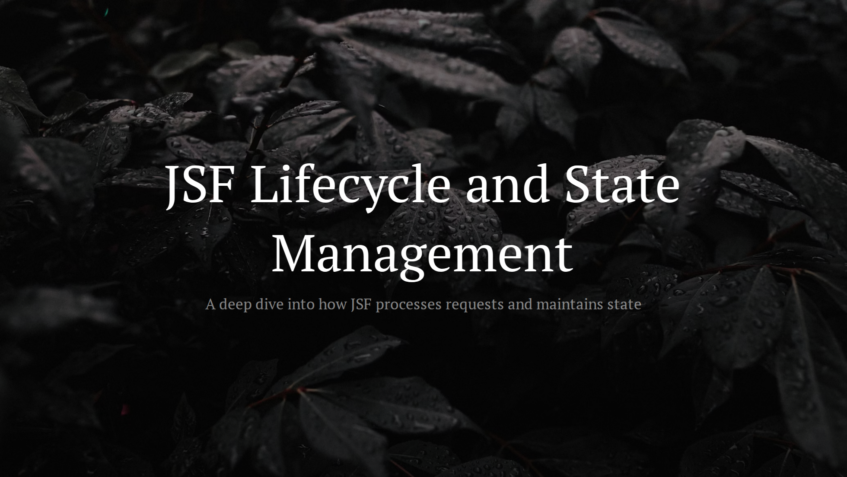

Slide 2
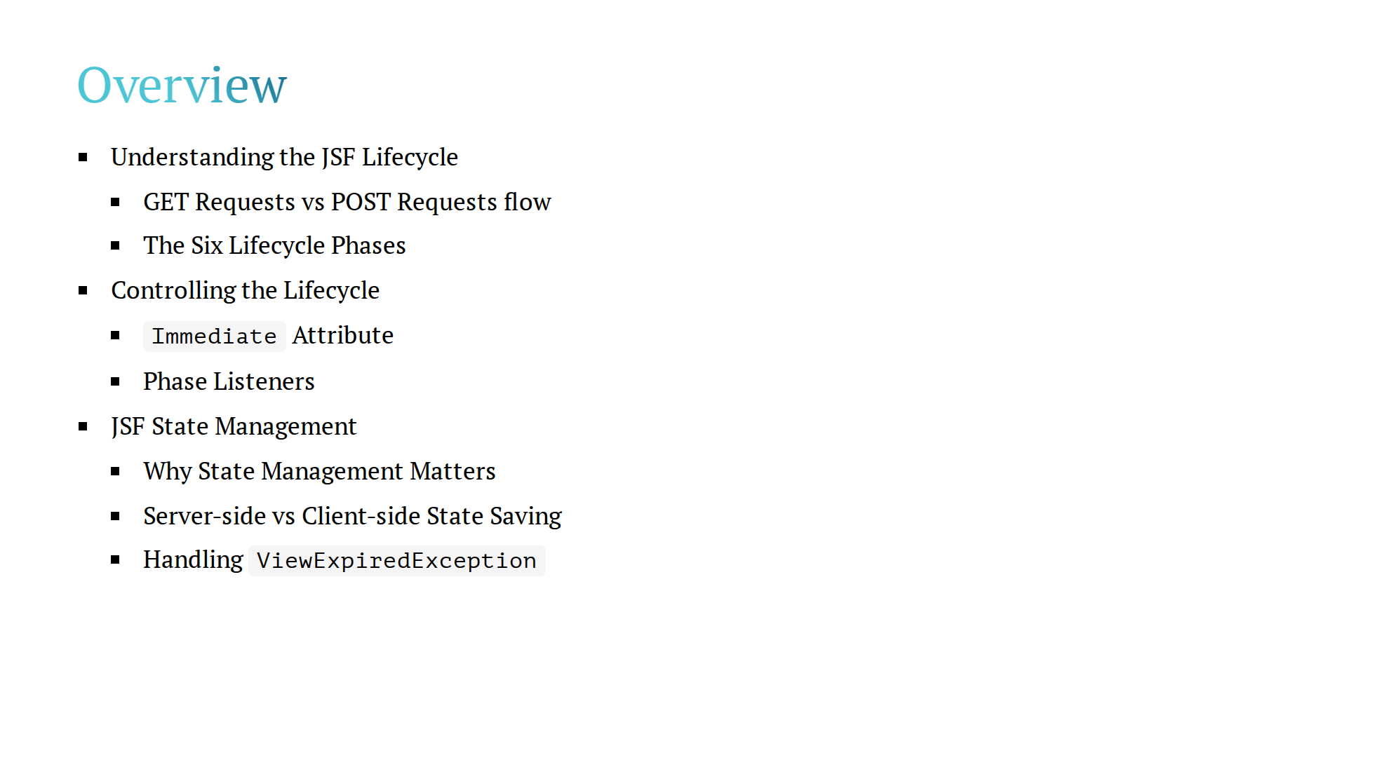

Slide 3
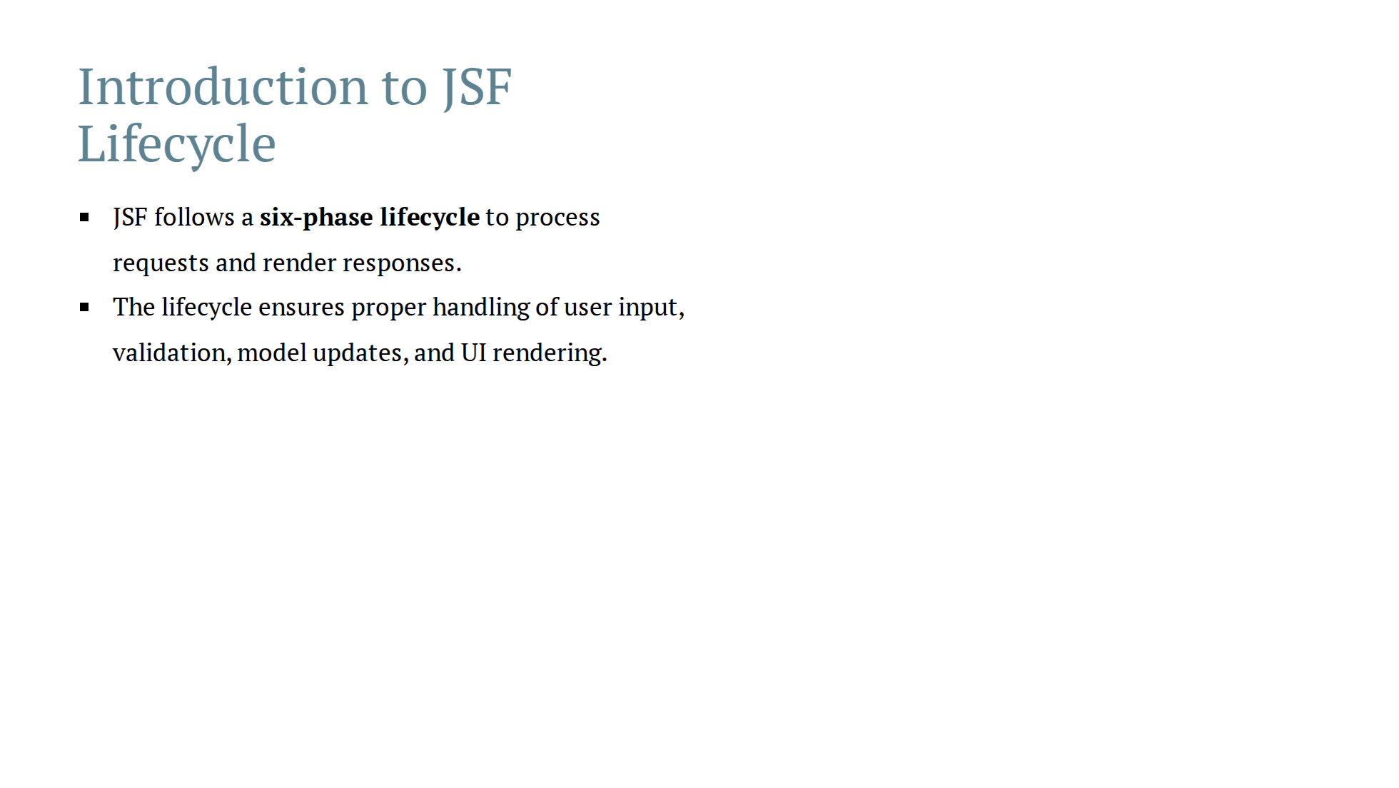

Slide 4
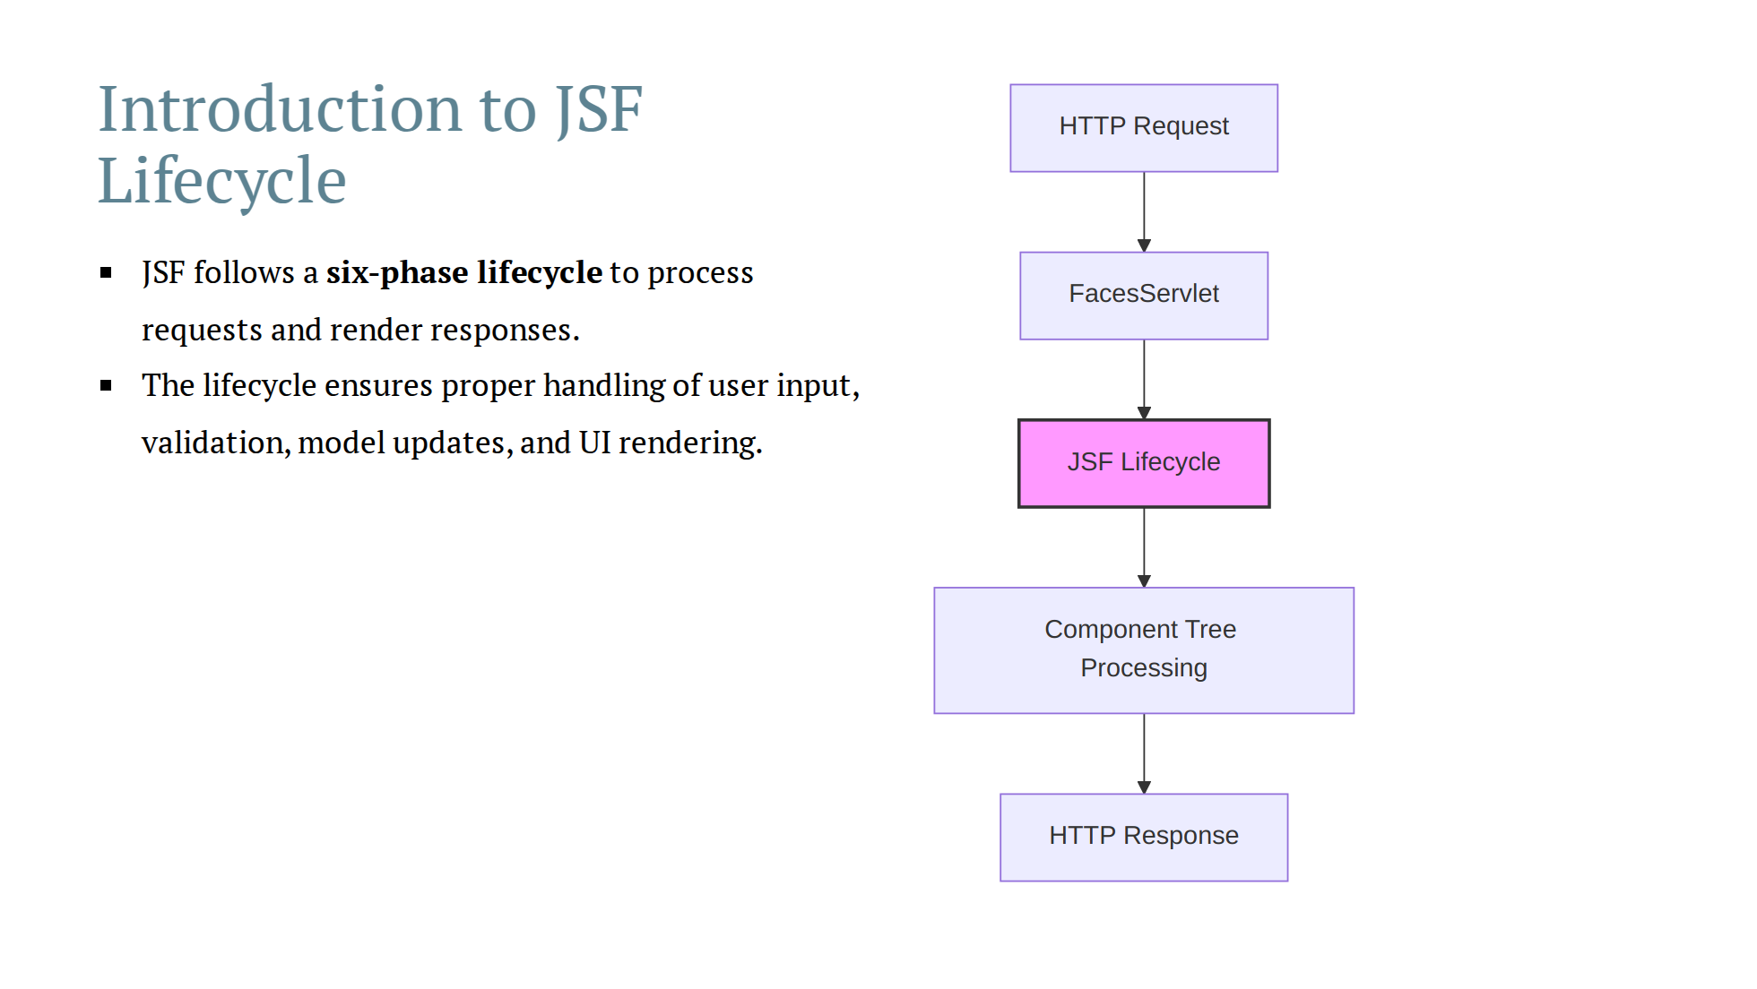

Slide 5
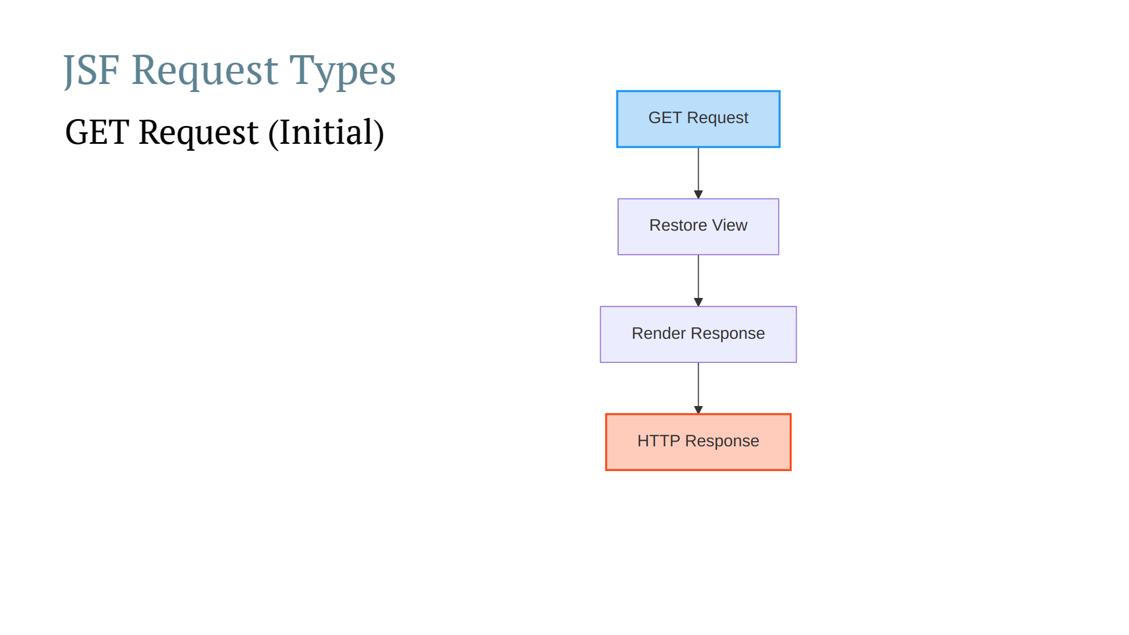

Slide 6
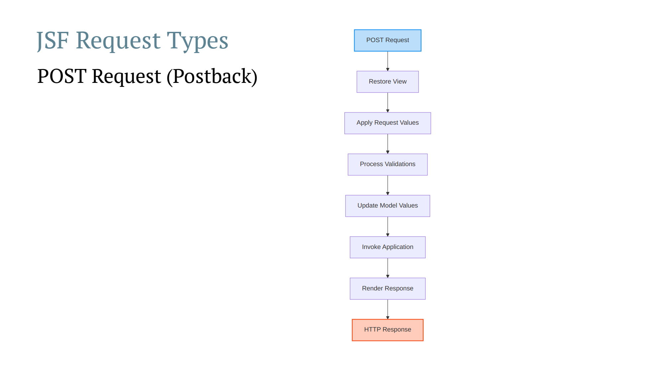

Slide 7
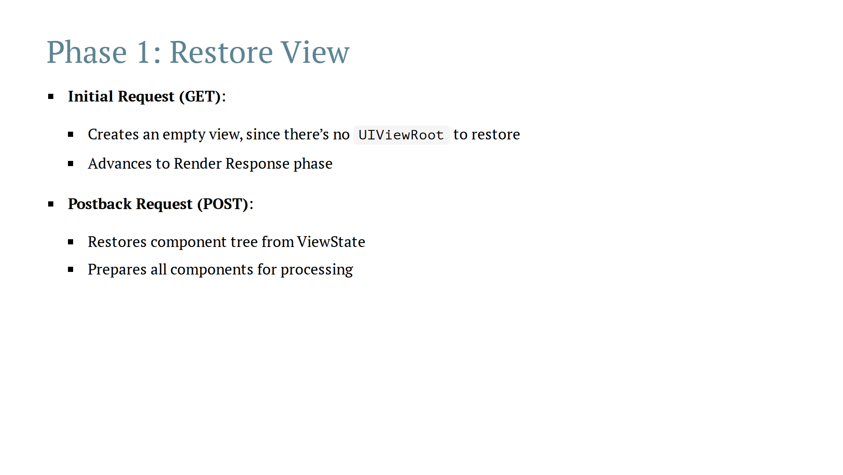

Slide 8
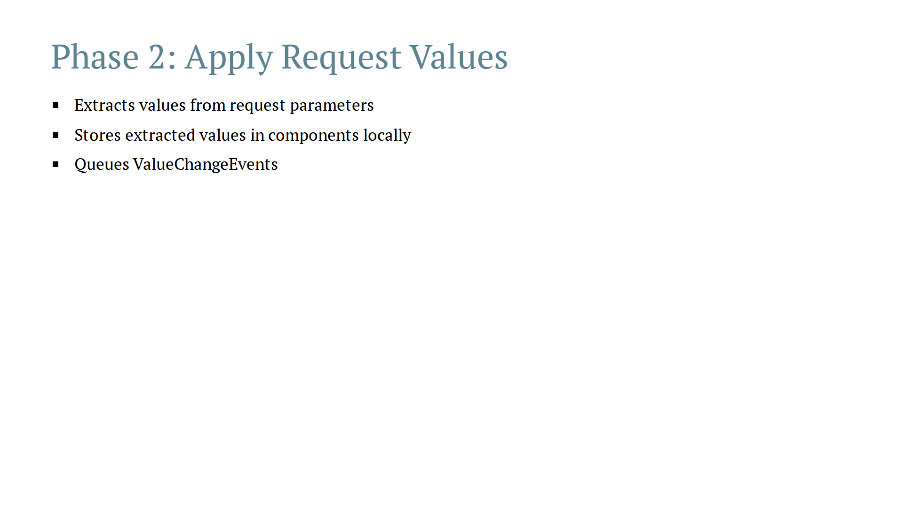

Slide 9
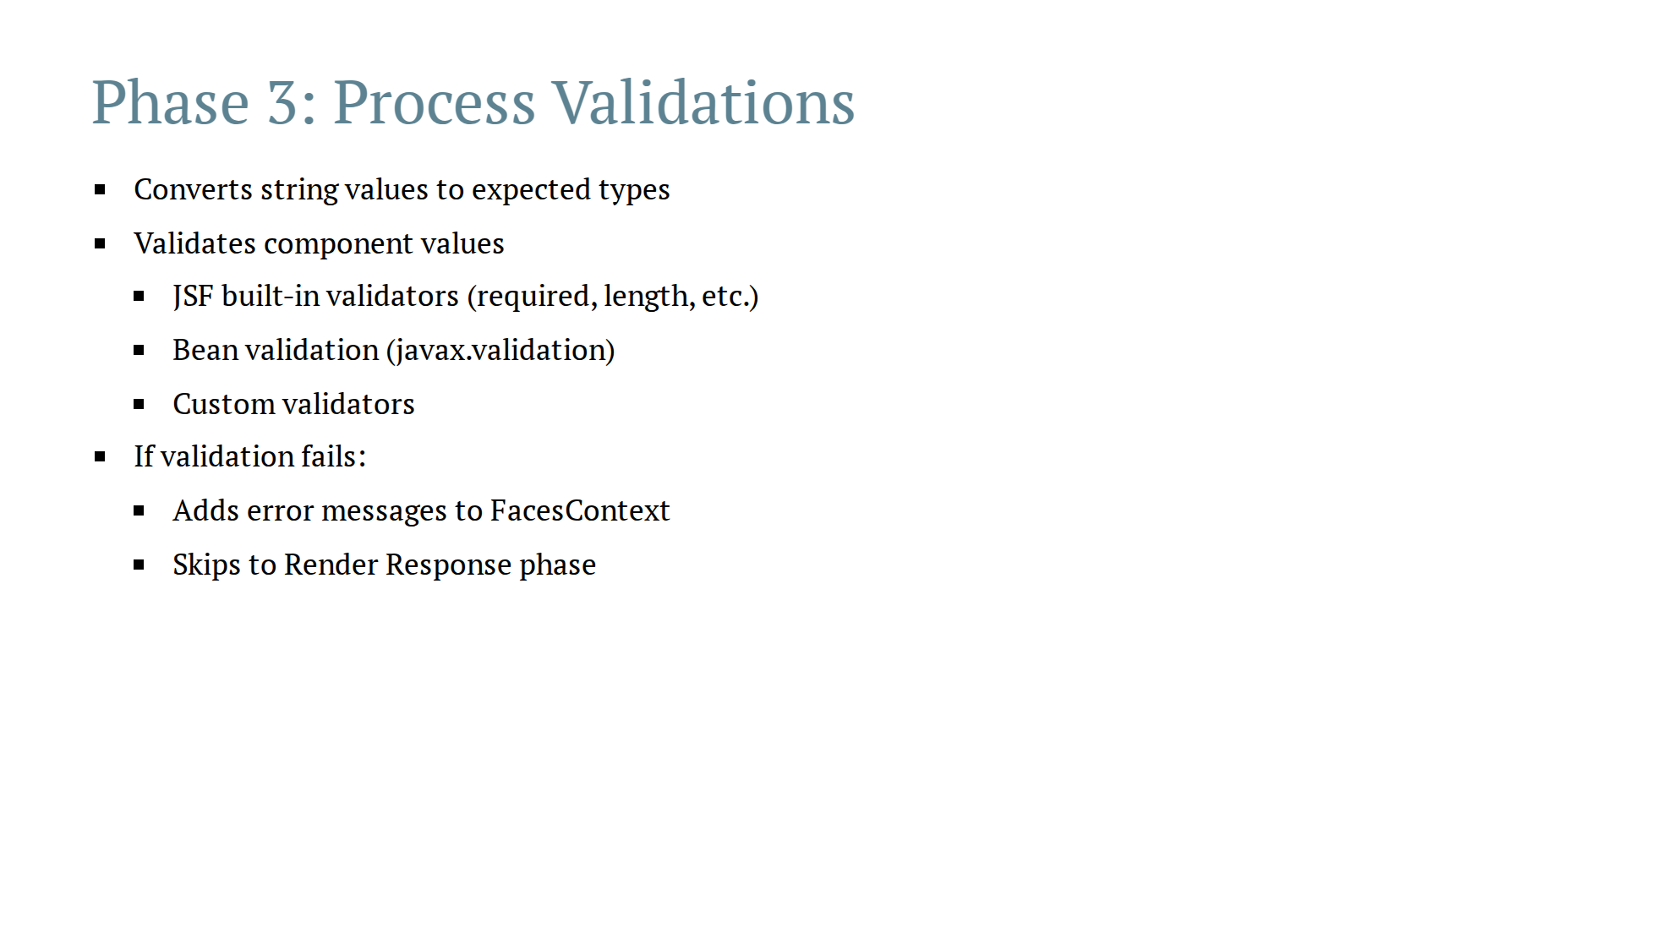
Notes:
Advantage of validation in this phase instead of backing bean methods is Jsf/bean validation runs validation for all the components even if one of them fails

Slide 10
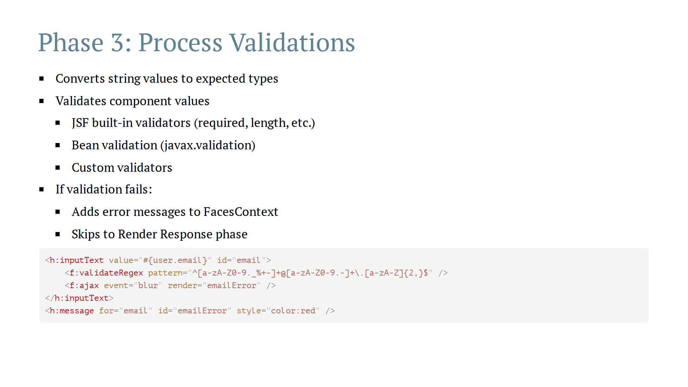
Notes:
Advantage of validation in this phase instead of backing bean methods is Jsf/bean validation runs validation for all the components even if one of them fails

Slide 11
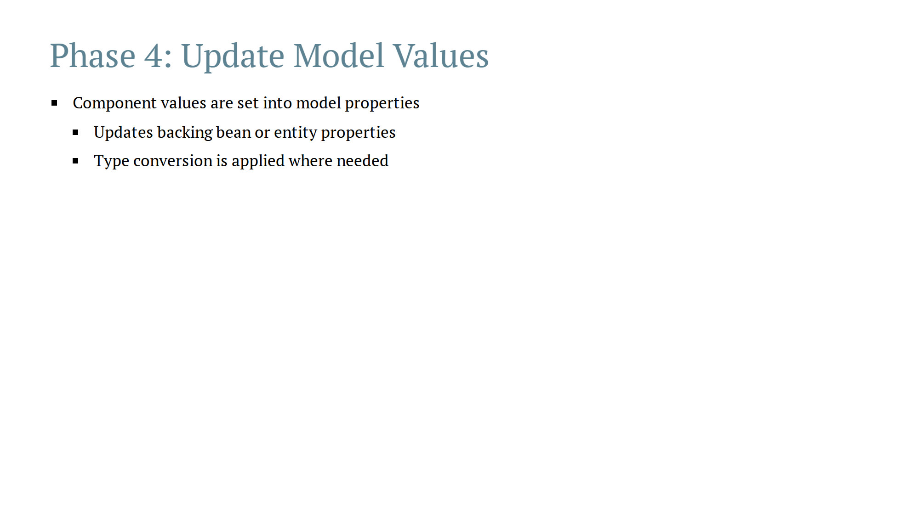

Slide 12
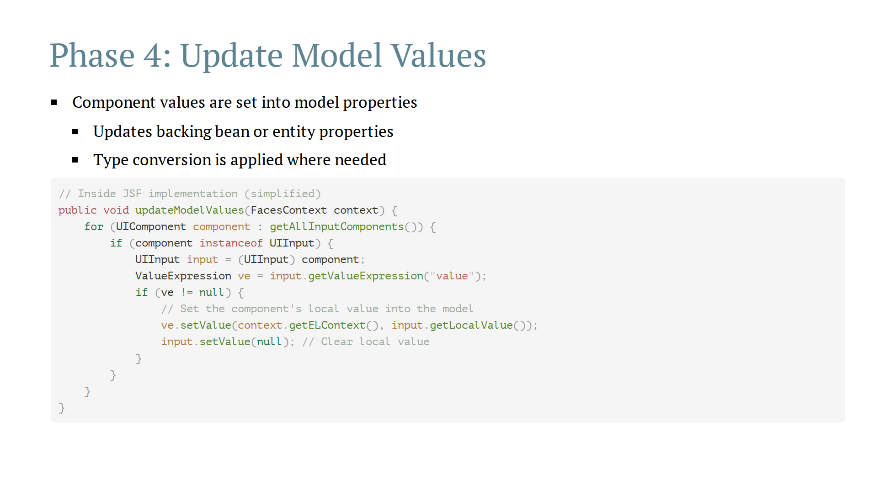

Slide 13
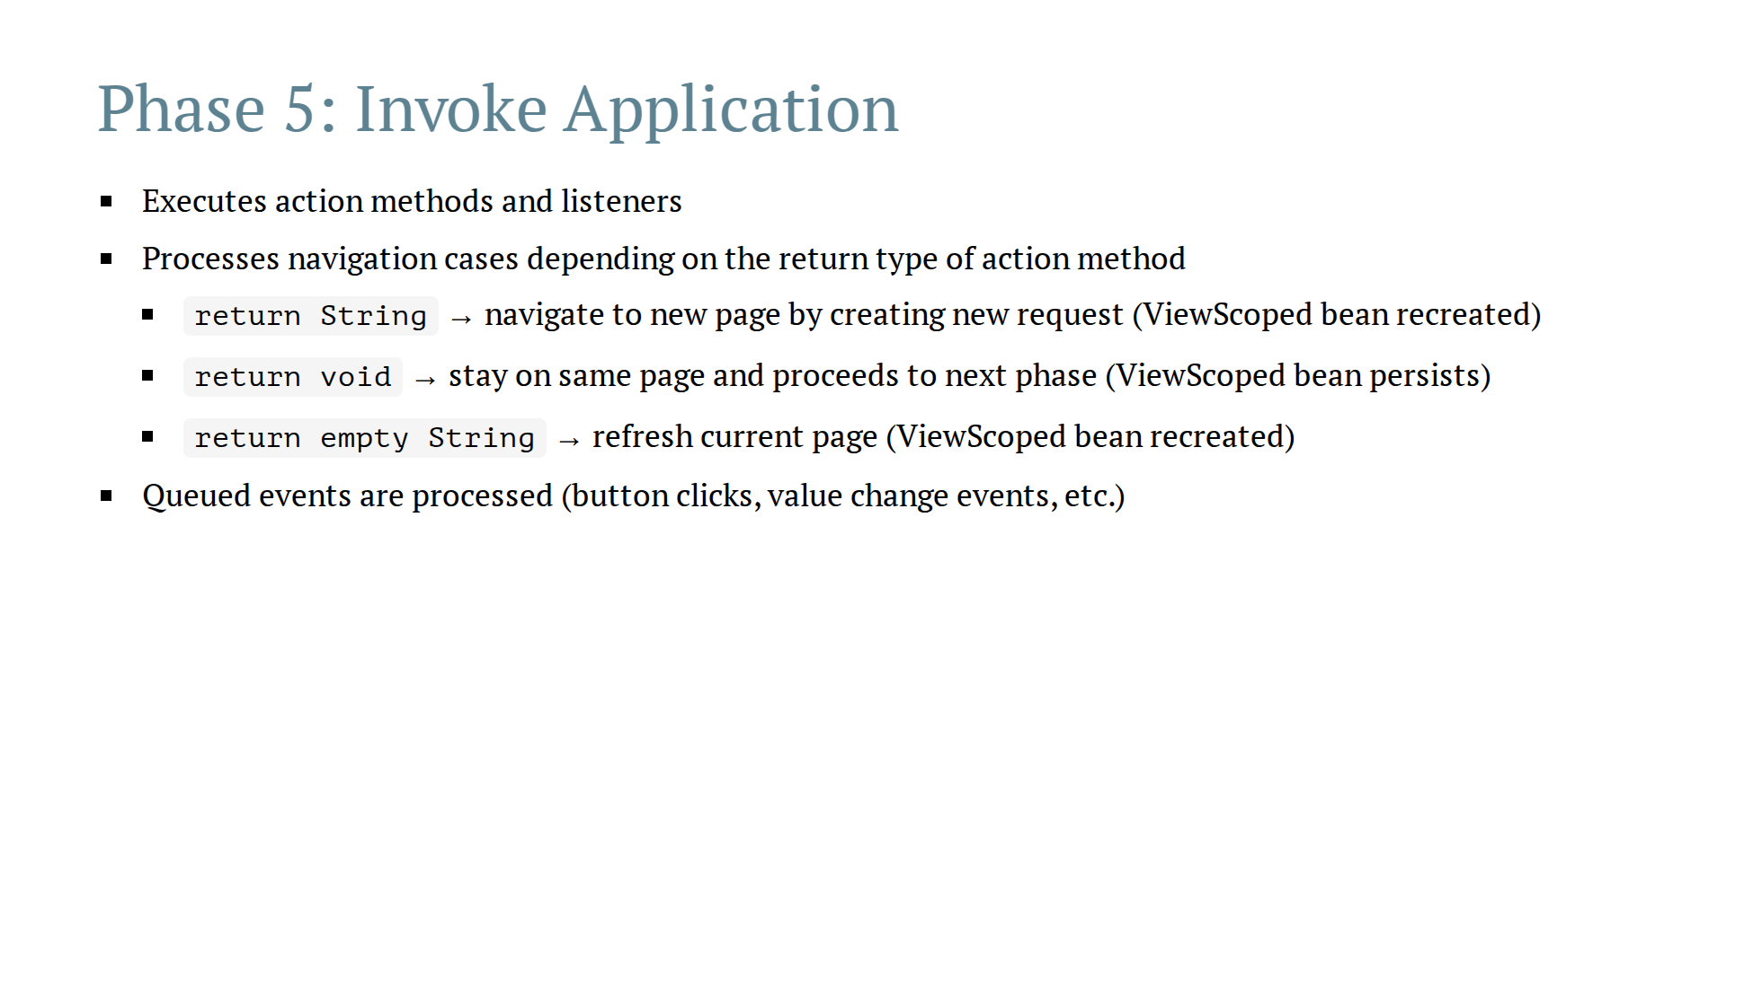

Slide 14
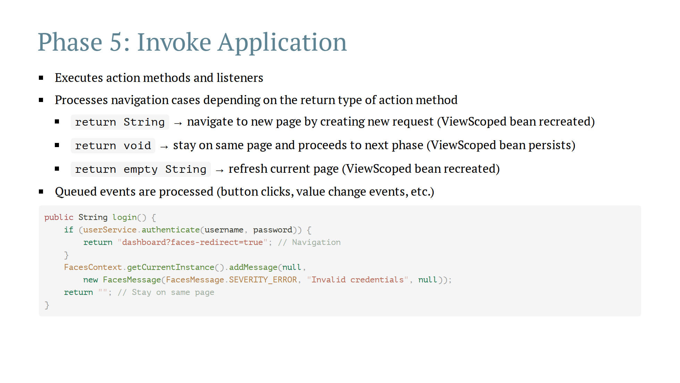

Slide 15
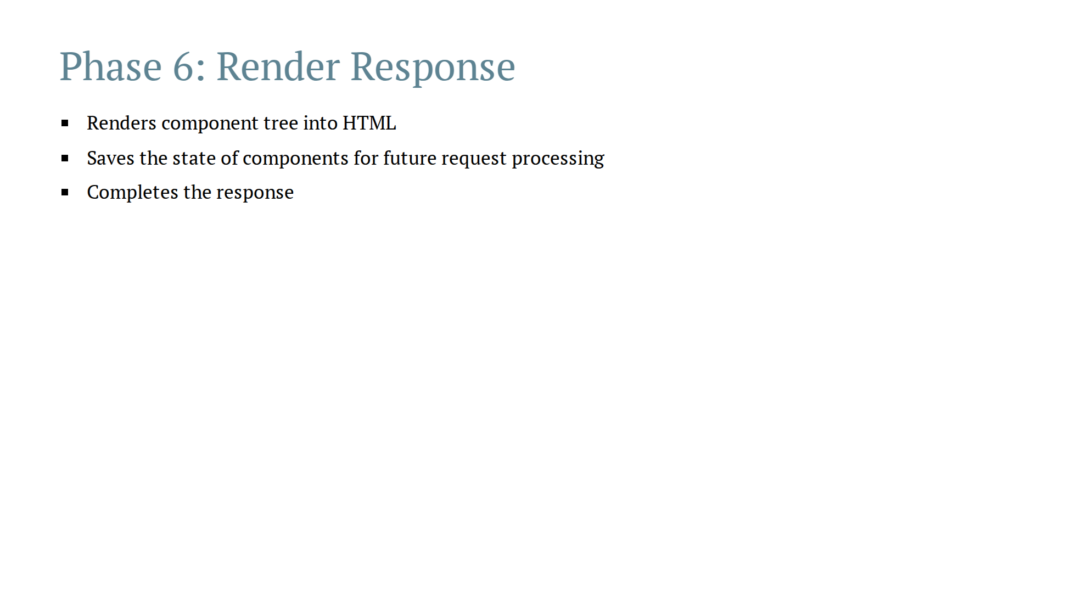

Slide 16
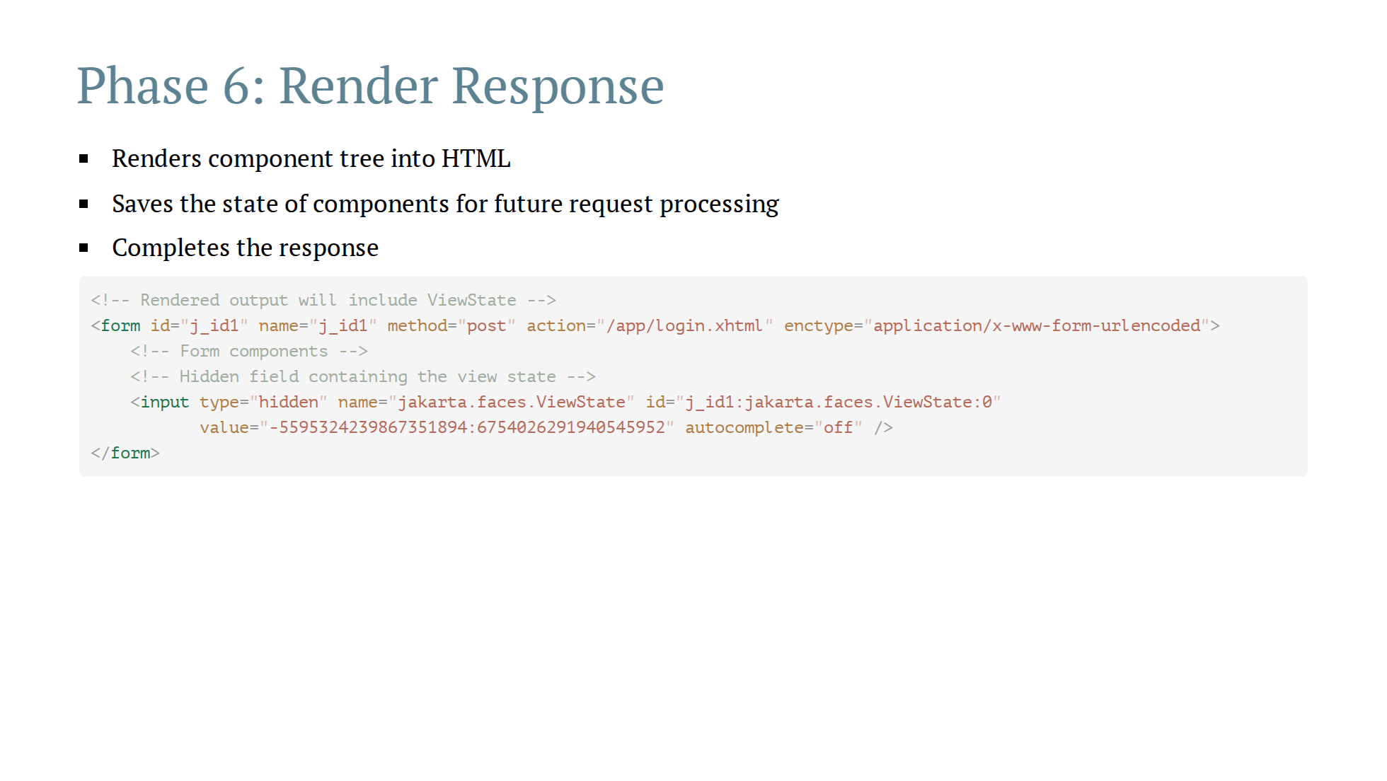

Slide 17
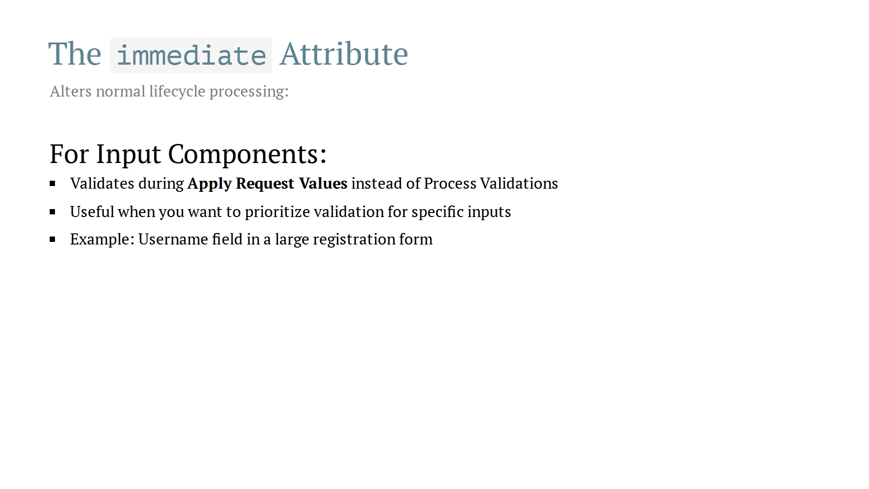

Slide 18
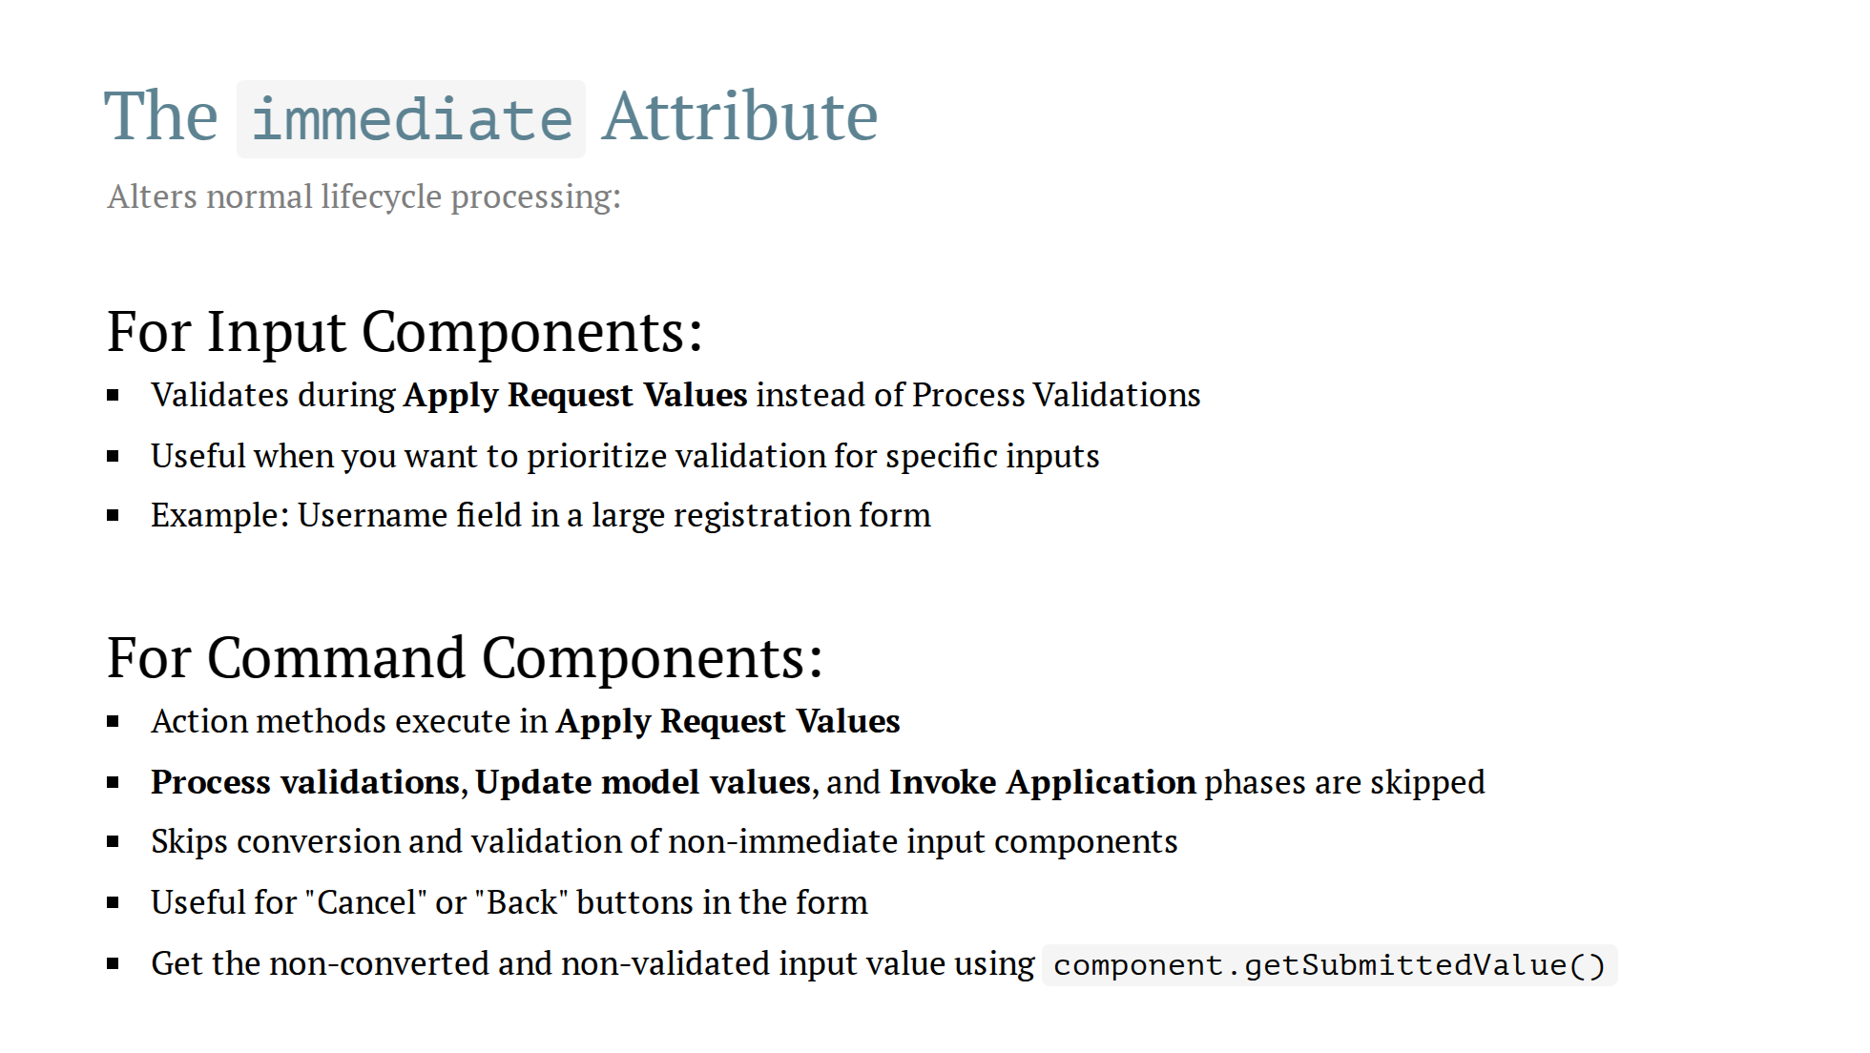

Slide 19
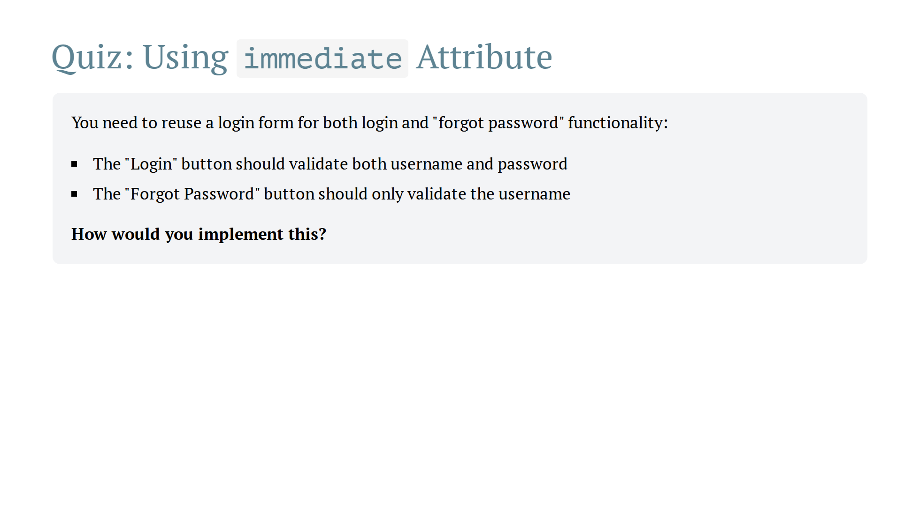

Slide 20
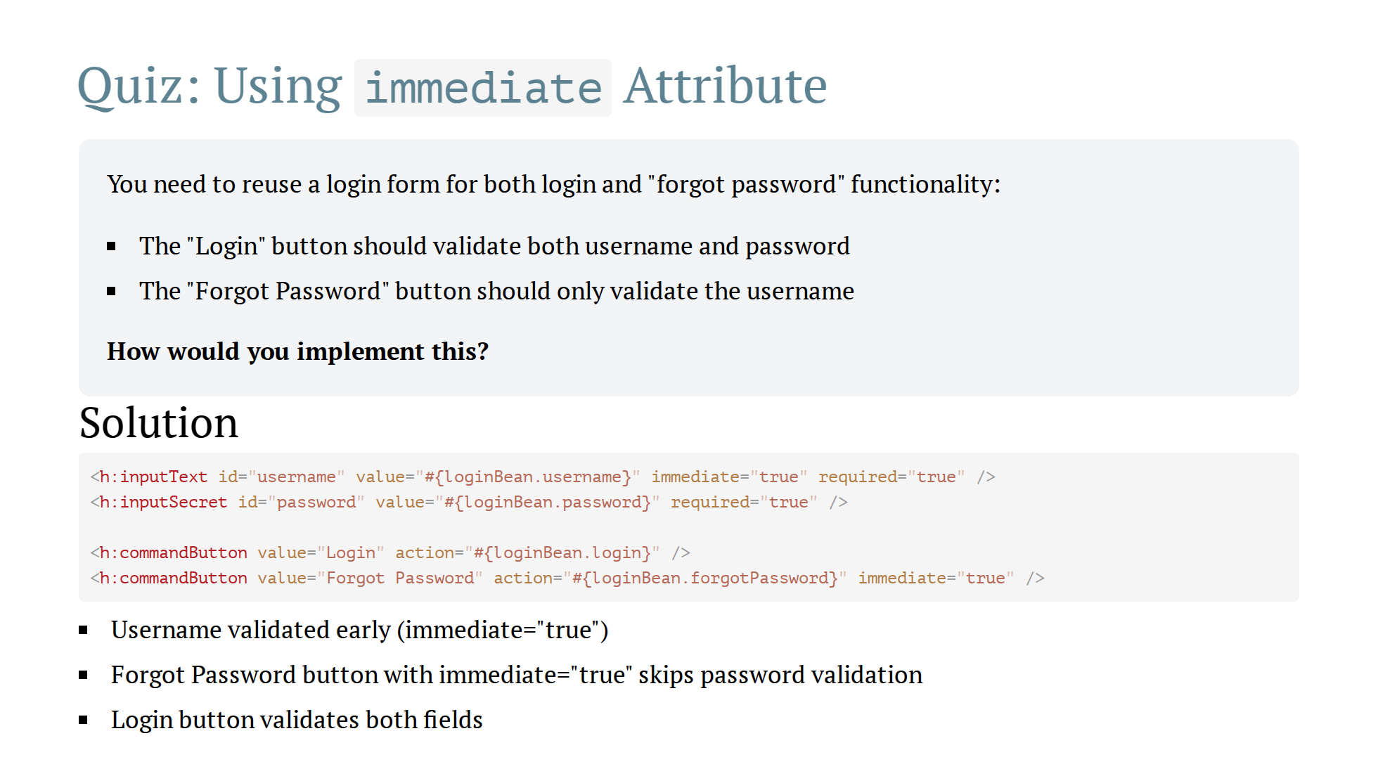

Slide 21
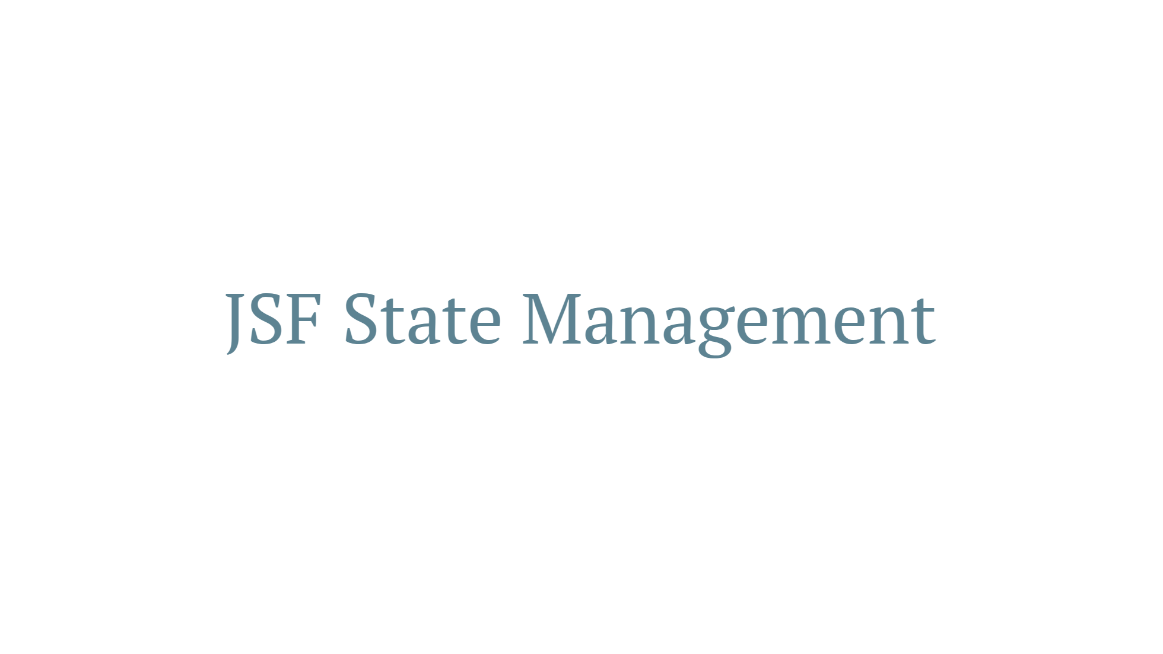

Slide 22
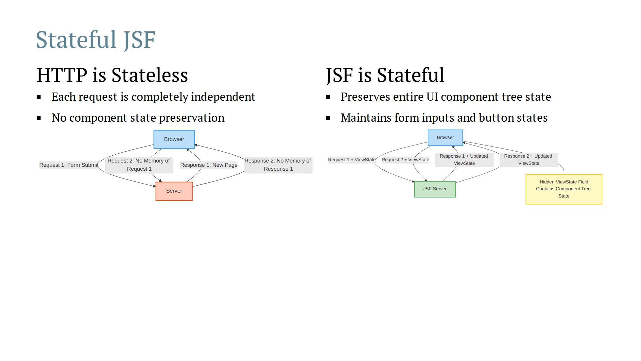
Notes:
Speaker Notes: - In HTTP, the server treats each request as brand new with no memory of previous interactions - JSF builds on top of HTTP by adding a state management layer (ViewState) - JSF's ViewState can be stored client-side (in a hidden field) or server-side (with just a reference ID sent to client) - This mechanism allows for rich UI components that maintain their state across the request-response cycle

Slide 23
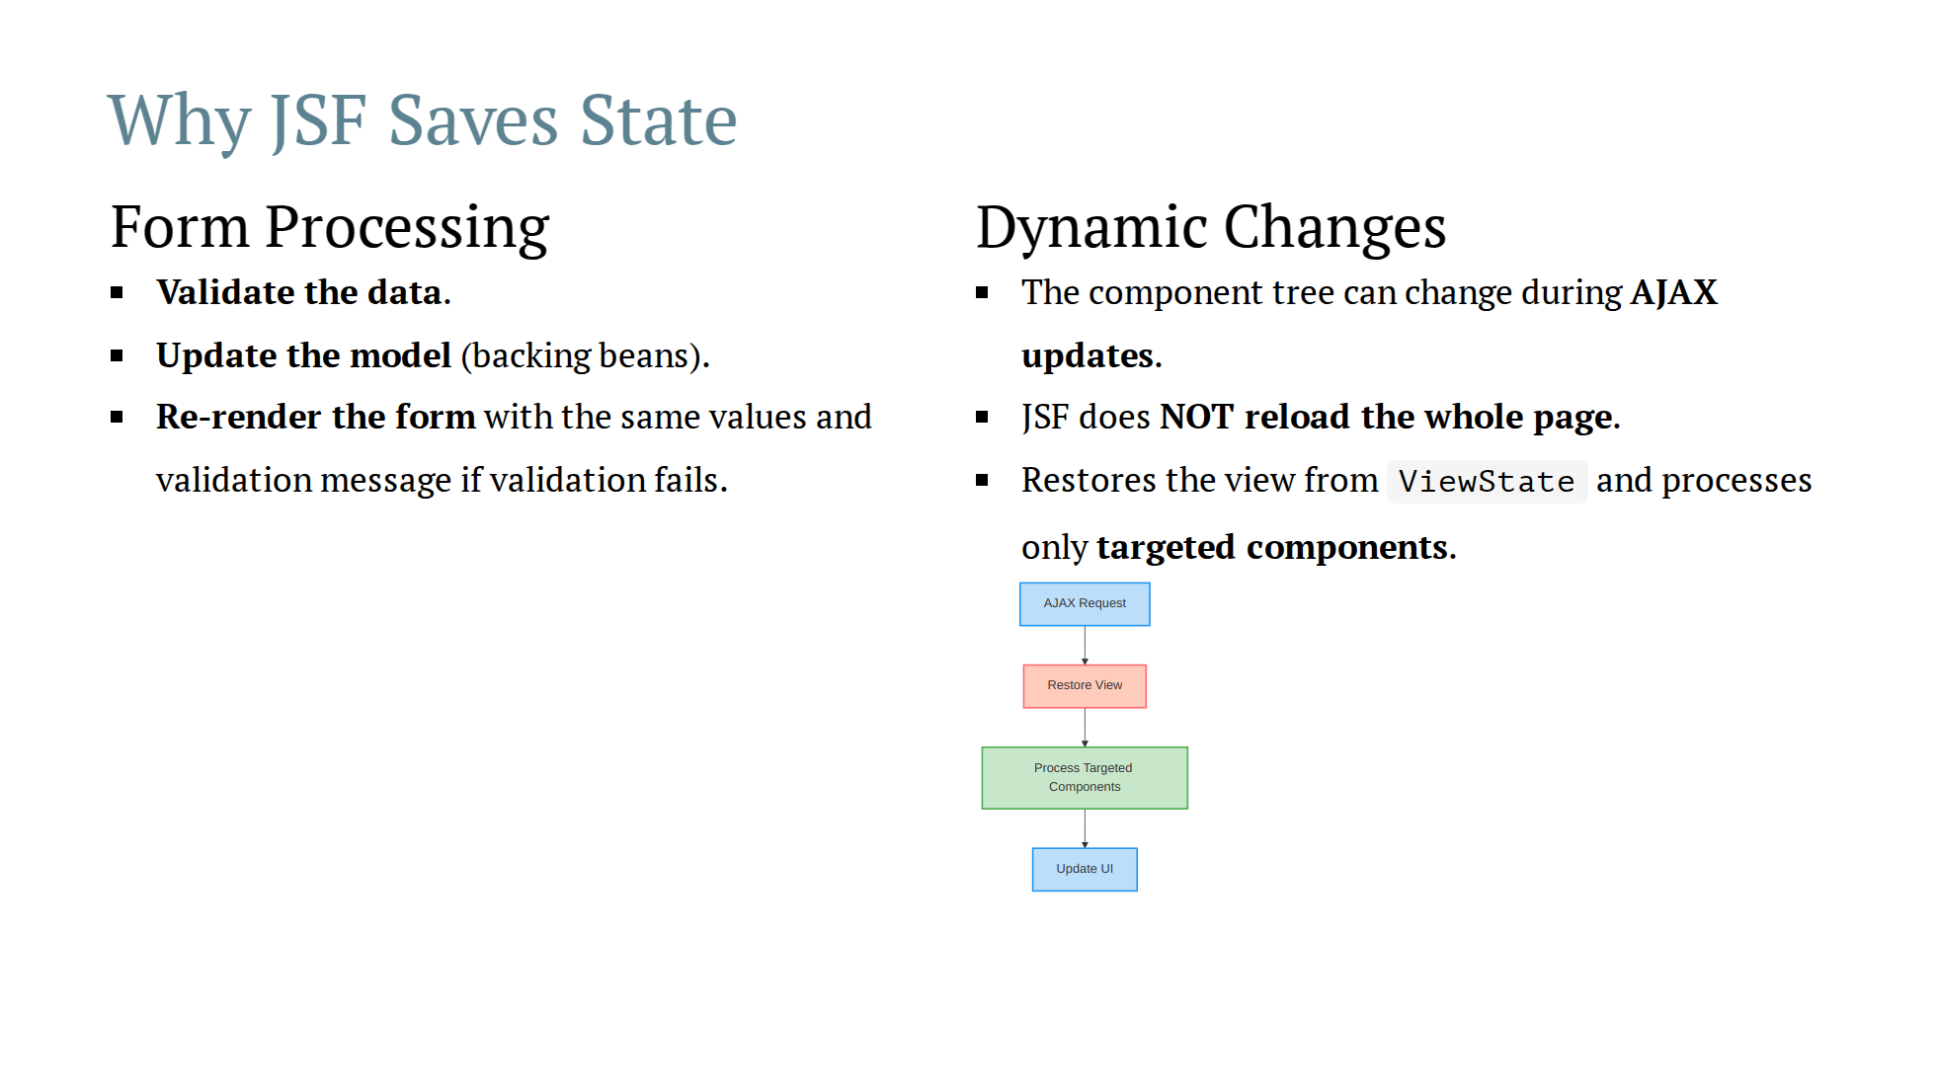

Slide 24
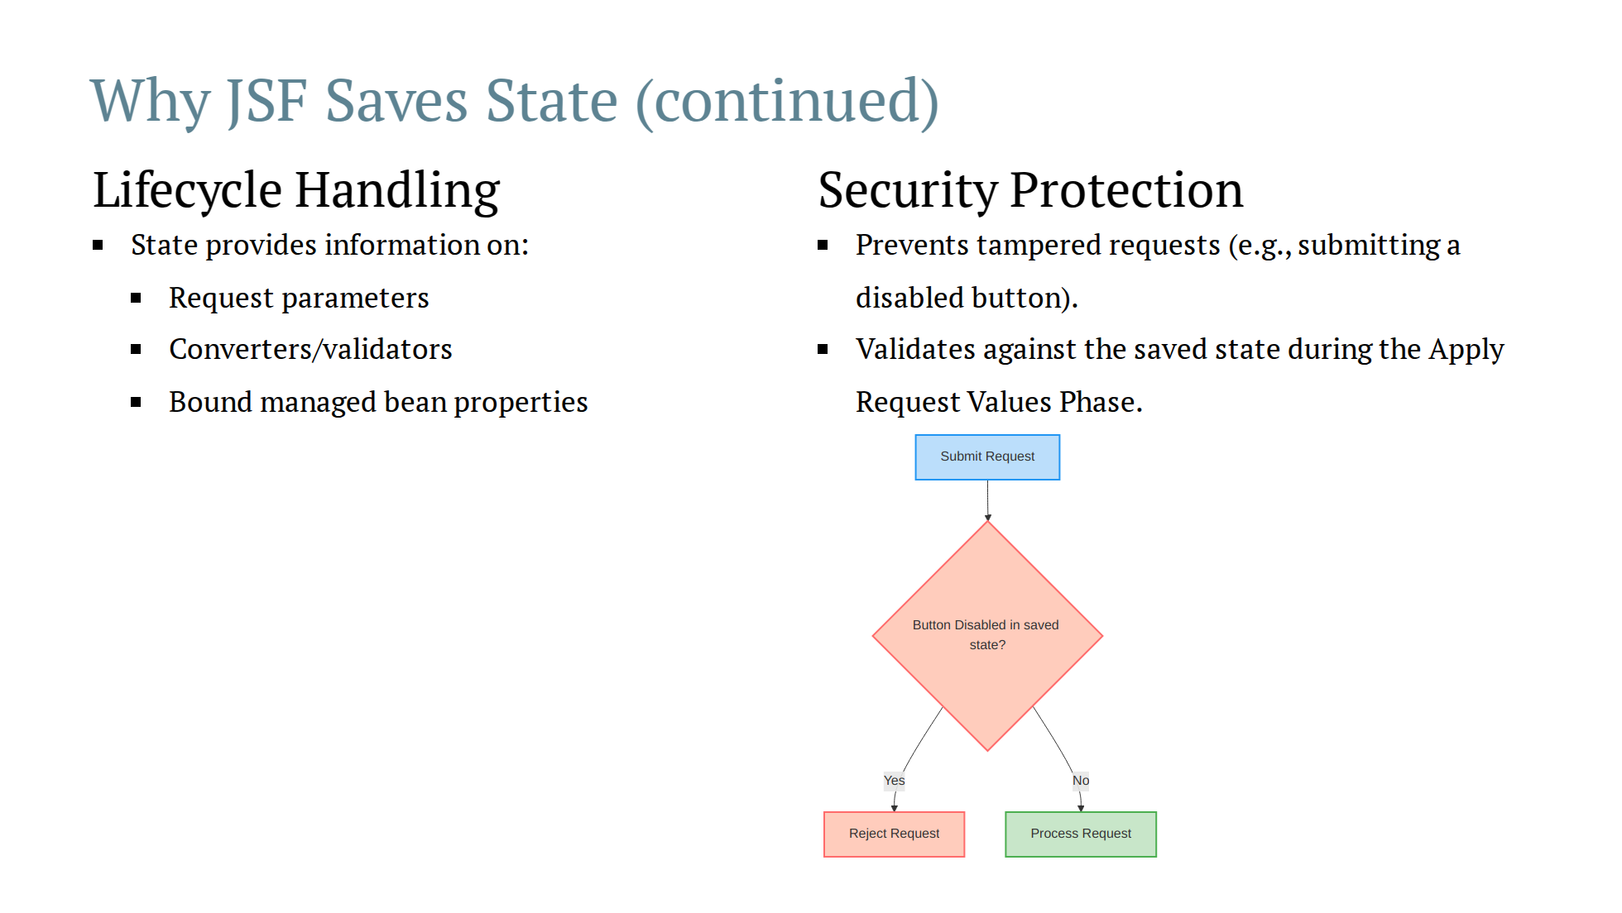
Notes:
- If a button was disabled in the original state but the request includes a submission for it, JSF rejects the request.

Slide 25
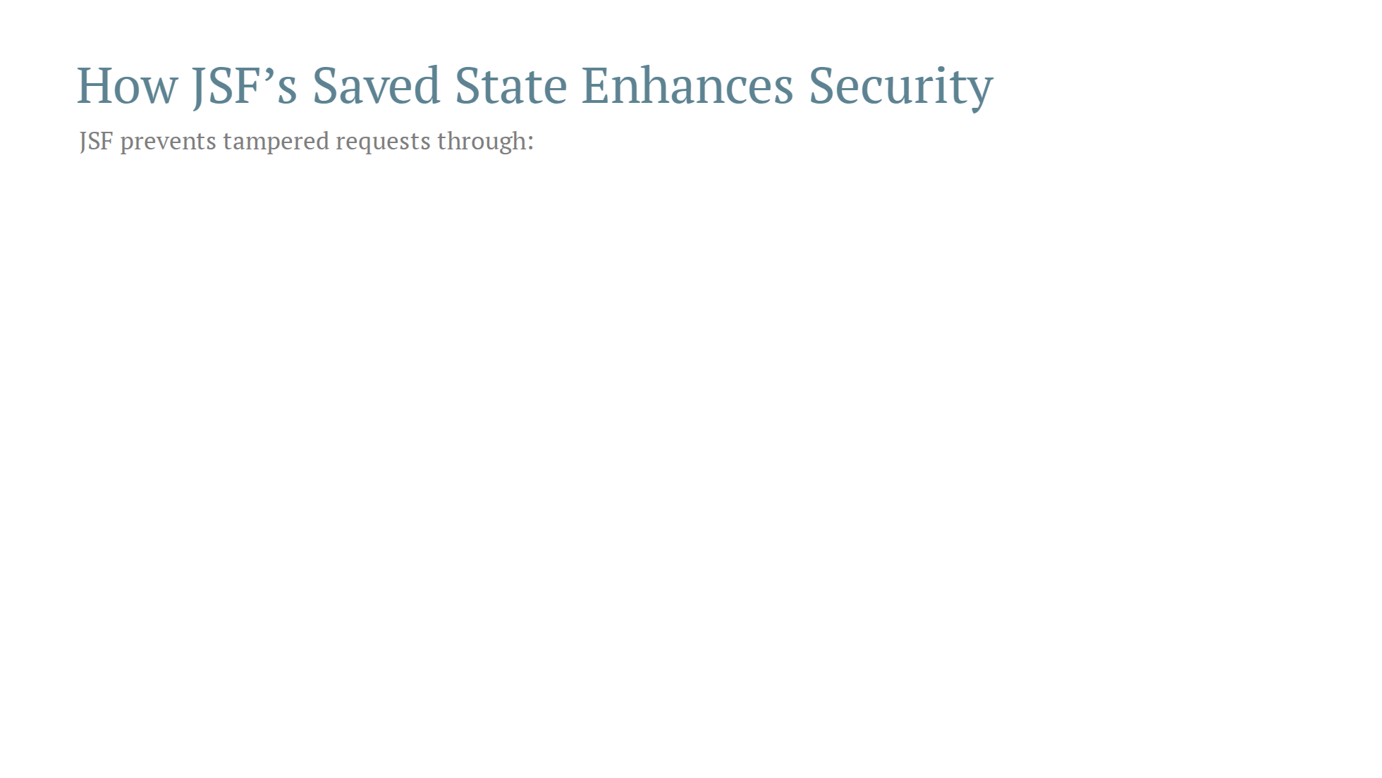

Slide 26
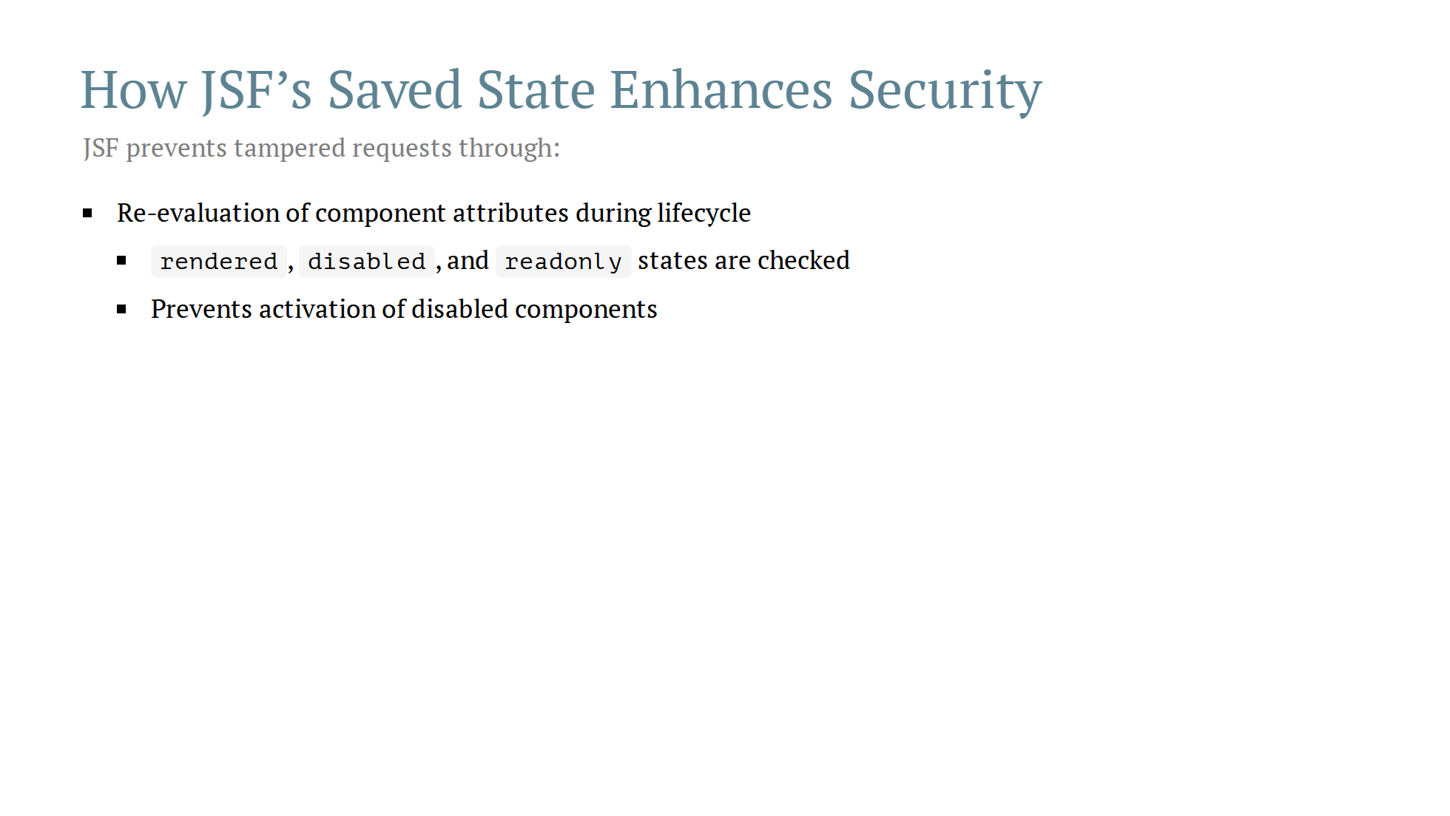

Slide 27
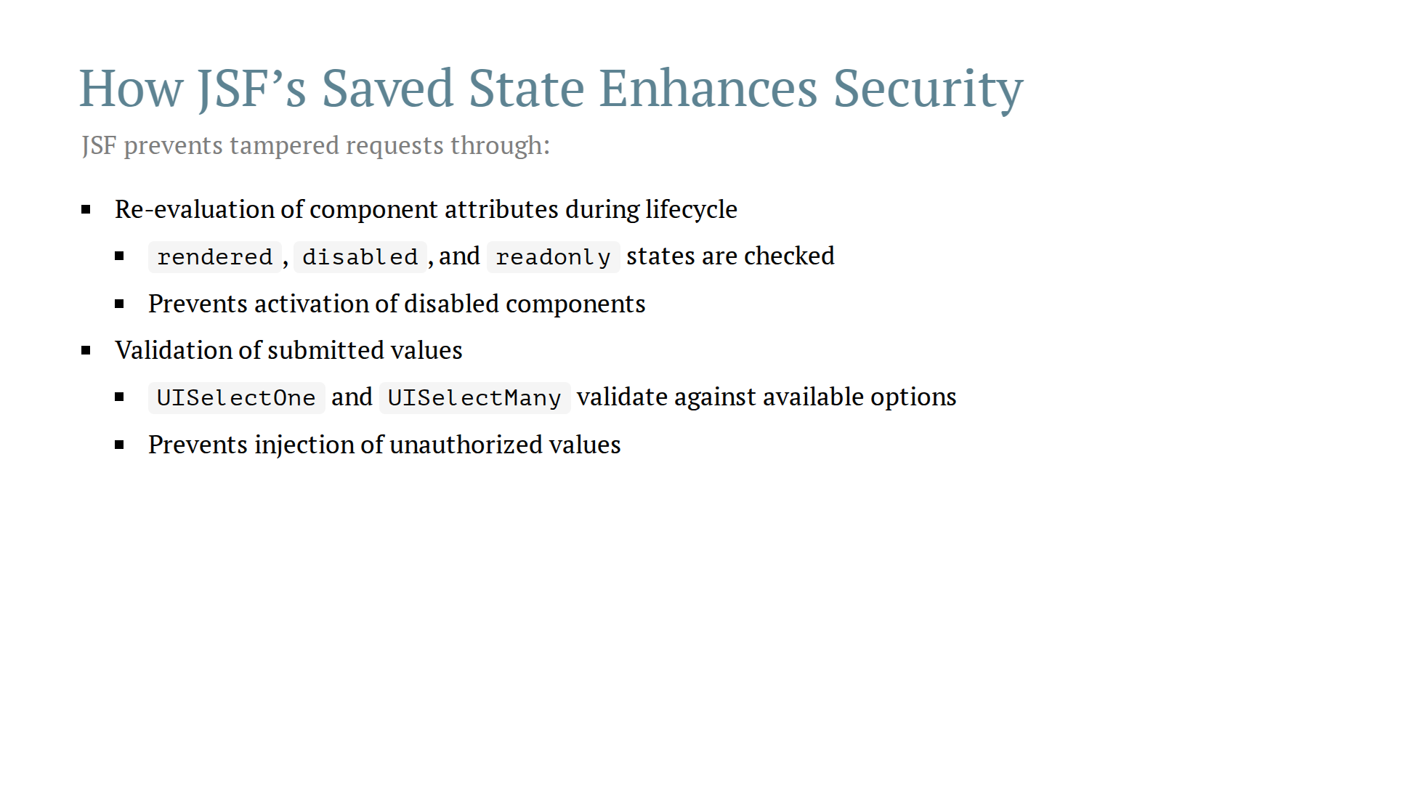

Slide 28
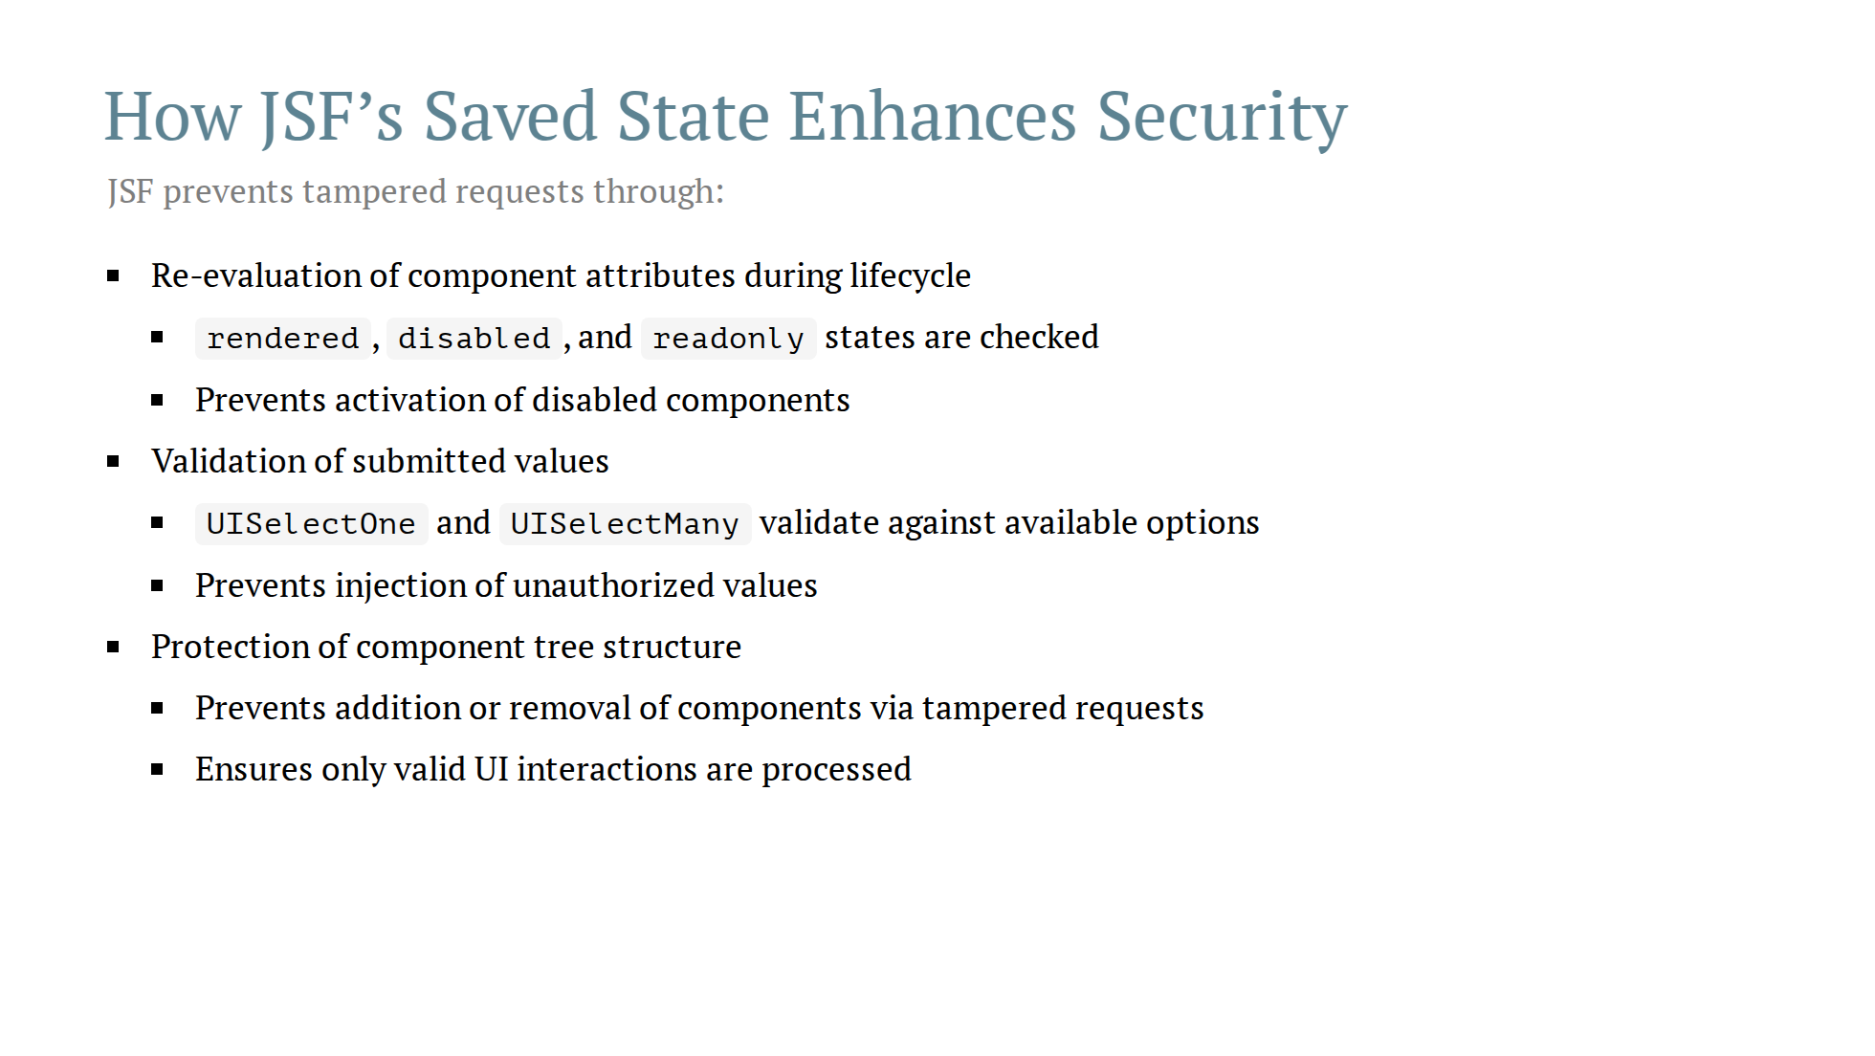

Slide 29
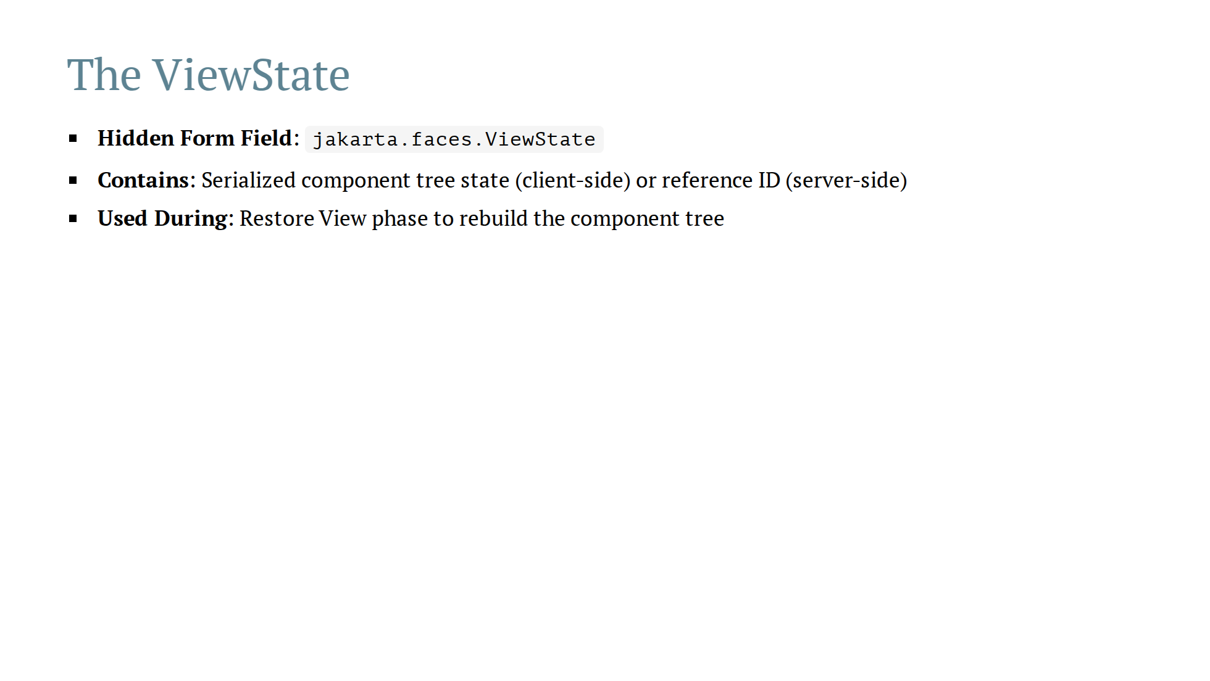

Slide 30
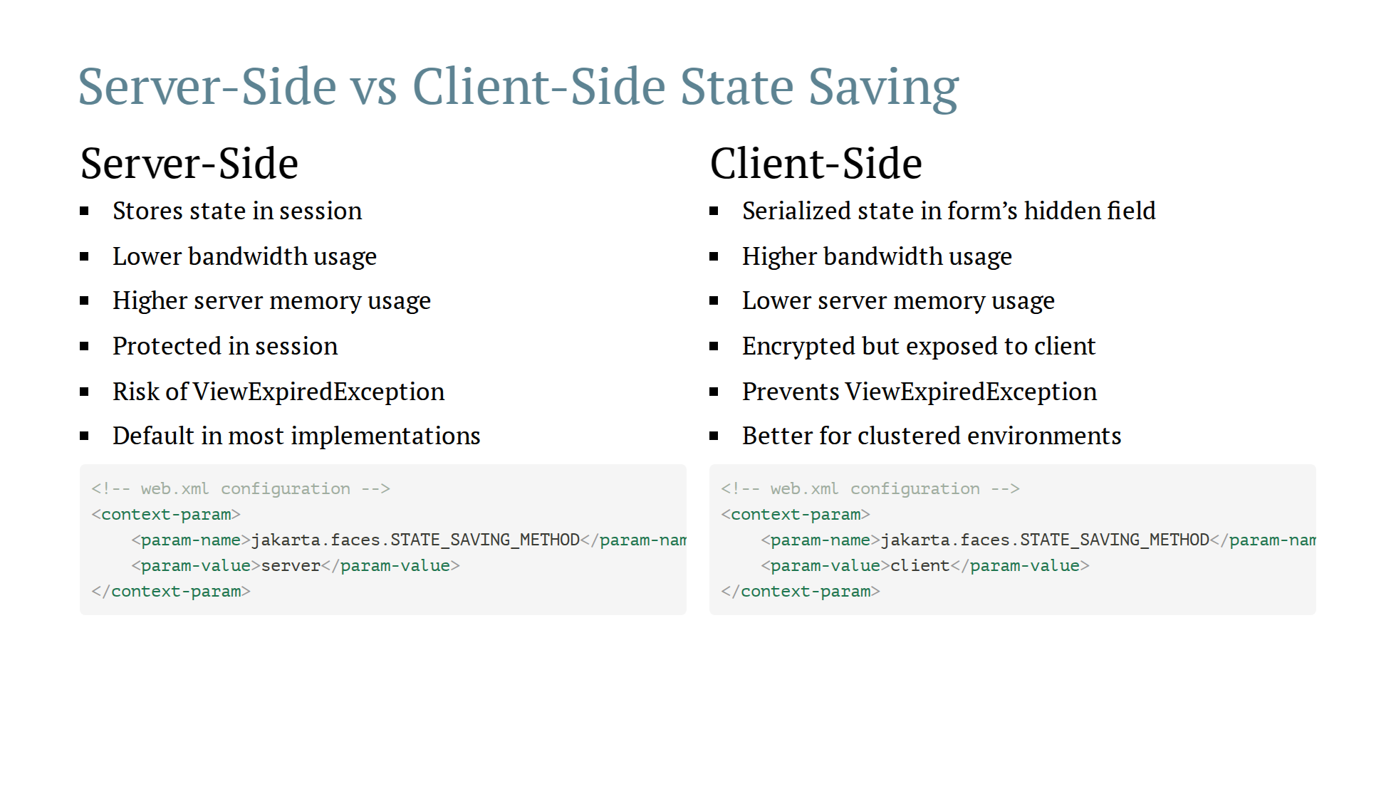
Notes:
--- # Server-Side vs Client-Side State Saving | Aspect | Server-Side | Client-Side | |--------|------------|-------------| | Storage Location | Session with ViewState reference | Hidden field in HTML | | Memory Usage | High (increases with users) | Low (no server storage) | | Bandwidth | Low (small reference) | High (serialized state) | | Security | Protected in session | Encrypted but client-exposed | | Performance | Better page load time | Slower due to serialization | | ViewExpiredException | Yes (session timeout) | No (state always available) | | Configuration | Default setting | Opt-in setting |

Slide 31
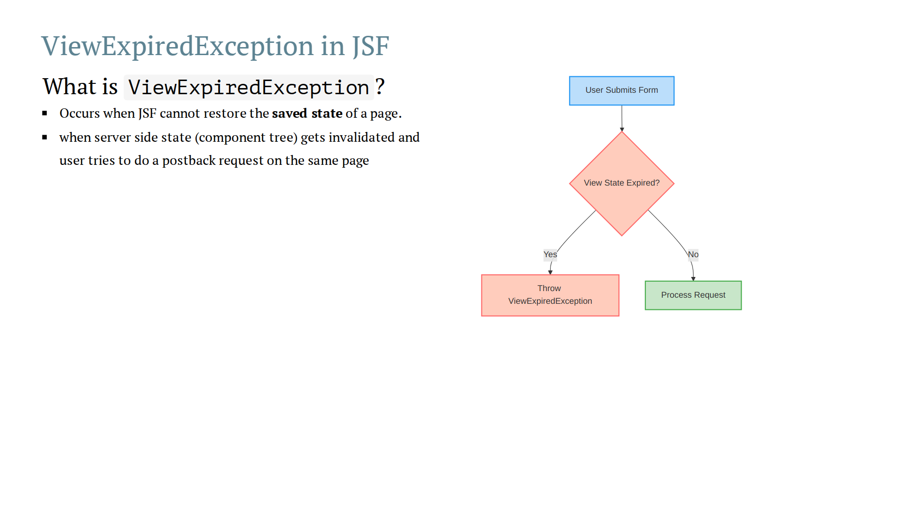
Notes:
Common causes 1. Session Timeout: - User fills out a form but leaves it open too long - Session expires on the server - When user submits, the ViewState cannot be found 2. Browser Navigation Issues: - User submits form and navigates to success page - Uses browser back button to return to previous page - Submits the form again, but the ViewState is no longer valid 3. Server-Side State Limits: - Server reaches maximum number of saved views - Oldest views are purged, causing exceptions

Slide 32
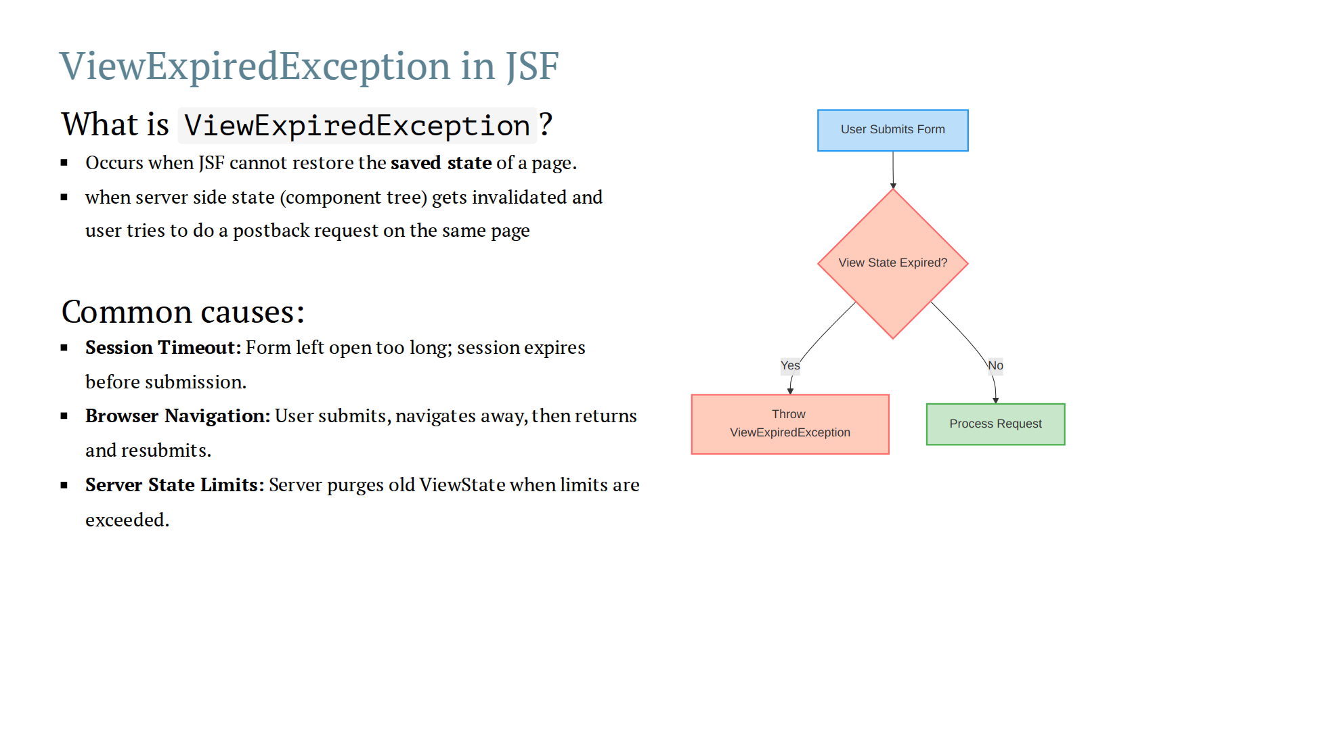
Notes:
Common causes 1. Session Timeout: - User fills out a form but leaves it open too long - Session expires on the server - When user submits, the ViewState cannot be found 2. Browser Navigation Issues: - User submits form and navigates to success page - Uses browser back button to return to previous page - Submits the form again, but the ViewState is no longer valid 3. Server-Side State Limits: - Server reaches maximum number of saved views - Oldest views are purged, causing exceptions

Slide 33
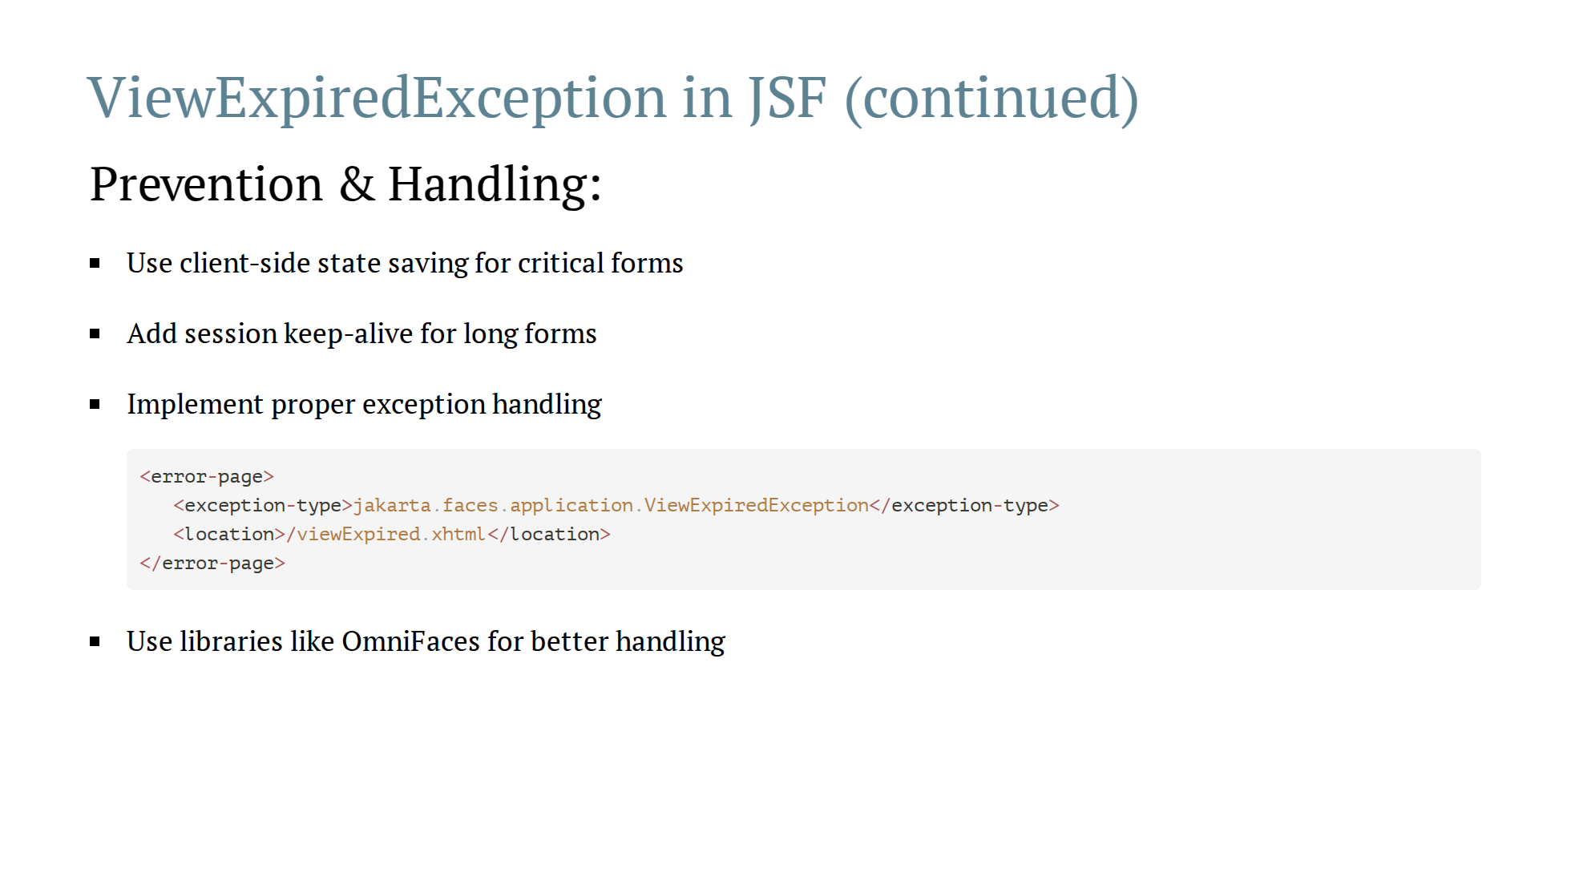

Slide 34
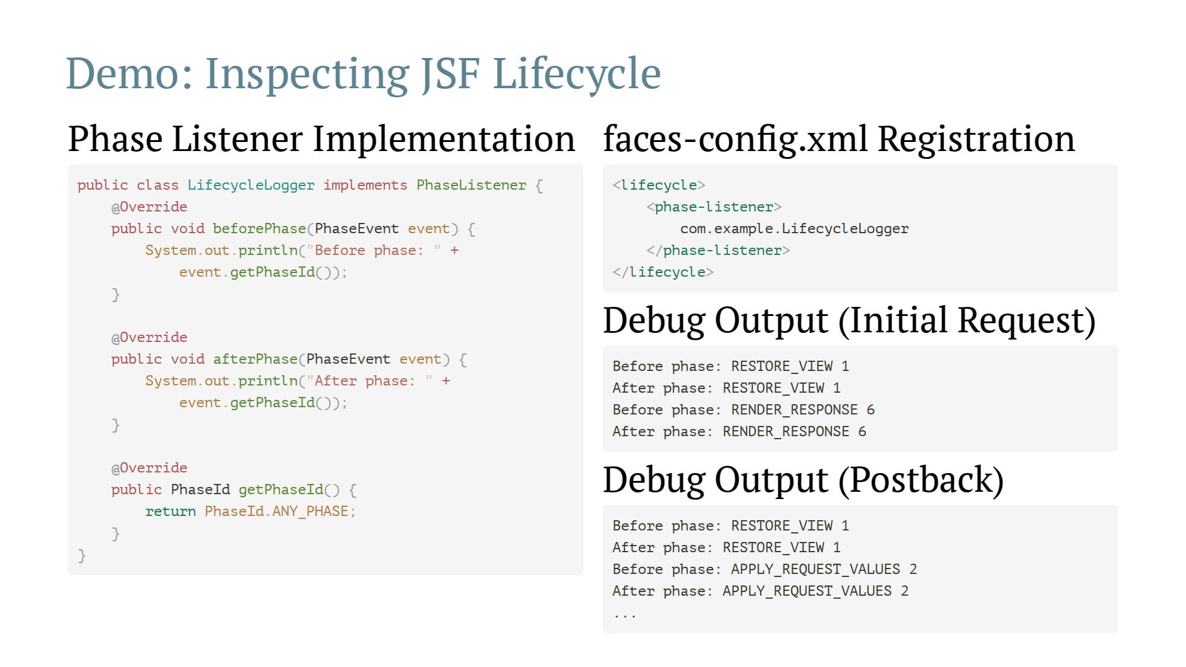

Slide 35
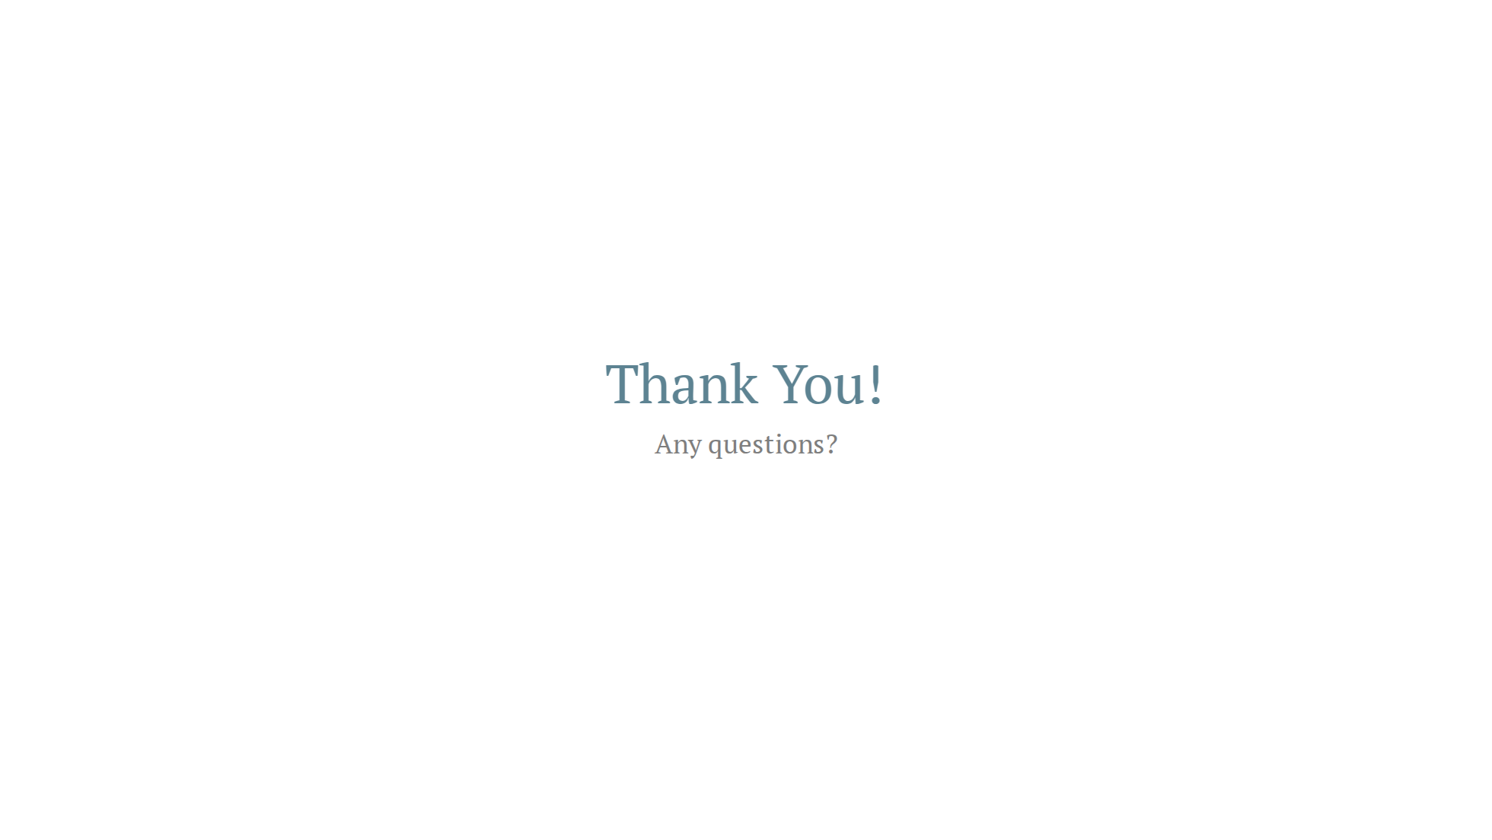

Slide 36
